Slide 1

Design and Analysis of FSAE Chassis Frame
B.Tech. Project (ME-3082) – 6th semester
Date: 28-03-2023
Presented by: Group No. - AM02
Supervisor(s)
Prof. Isham Panigrahi
Deputy Director KIIT Student Research Center
Antarik Dutt | Roll No:2009002
School of Mechanical Engineering
KIIT, Bhubaneswar

Slide 2
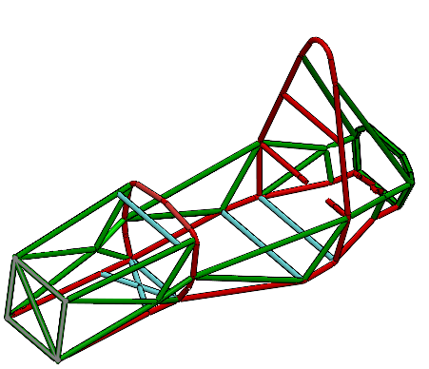
Table of contents
Chassis
Introduction
Literature review
Objectives
Problem definition
Calculation
Calculation of Torsional Stiffness
Calculation of Impact Test
Solid model Iterations
Force Analysis
Fig 1. FSAE Chassis

Slide 3
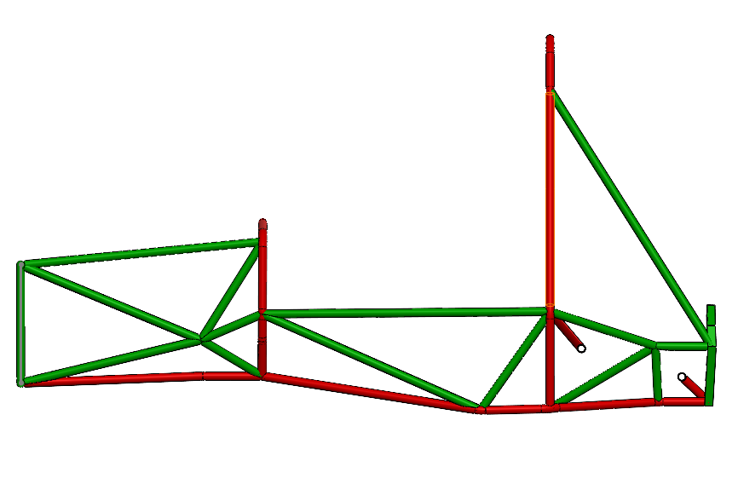
Introduction
Chassis is the main skeleton of the vehicle onto which the subsystems are fitted.
It provides structure to the vehicle and also gives sufficient space for the packaging.
Tubular space frame chassis is highly complex and the 3rd most heaviest thing in a vehicle
Fig 2. FSAE Chassis for Comet

Slide 4
Literature Review
Author | Year | Contribution
Dodd ET AL. | 2017 | How to make iterations on an FSAE chassis frame so that the torsional rigidity is sustained. Suitable range for torsional stiffness which was around 800-900 Nm/deg
Baskara ET AL. | 2018 | Analyze the chassis frame for different tests like torsional stiffness and impact test. Where the nodes should be fixed and where should the force be given.
Scaperdas ET AL. | 2012 | Design calculations for the simulation. Design of clamping mechanism and calculation for static roll hoop test.

Slide 5
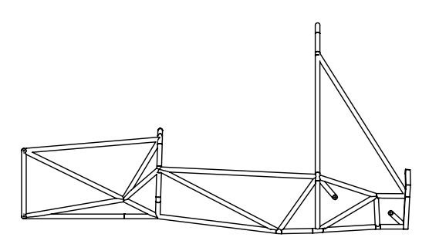
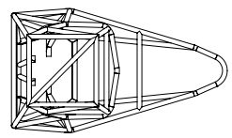
Objective
Objective
The aim of this project is to design and analyze a new FSAE chassis for the 2023 racing season. The team has been given the task of iterating on the successful FSAE 2019 car that went to competition.
Major objective:
Conform to all FSAE chassis rules
To design a space frame chassis which is light, has adequate stiffness and
should be compact.
Analyze the final design
Document the process for future designs

Slide 6
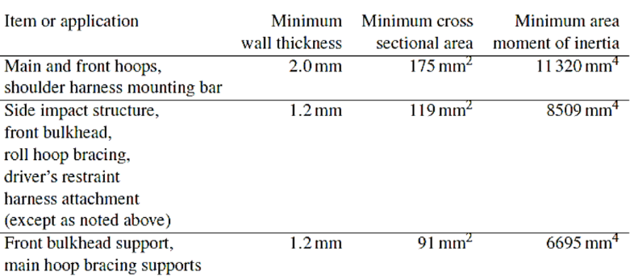
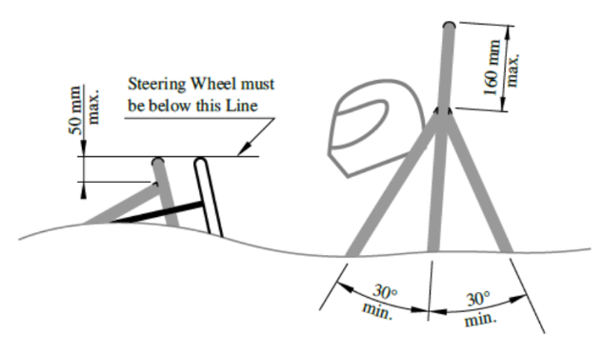
Problem definition
Tubing specifications - The dimensions of the tubing to be used for the frame are specified from rule T3.4 of the FSAE Rules.
Roll hoop dimensioning - The main and front roll hoop are to comply with rules T3.11 and T3.12 stating required hoop characteristics such as max angle from vertical, bend requirements, and minimum dimensions.
Bracing - The bracing for the main and front roll hoops are explicitly stated in rules T3.13 and T3.14 describing the requirements for bracing angle and dimensions.

Slide 7
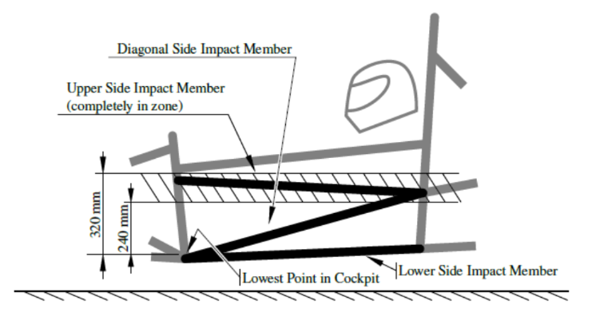
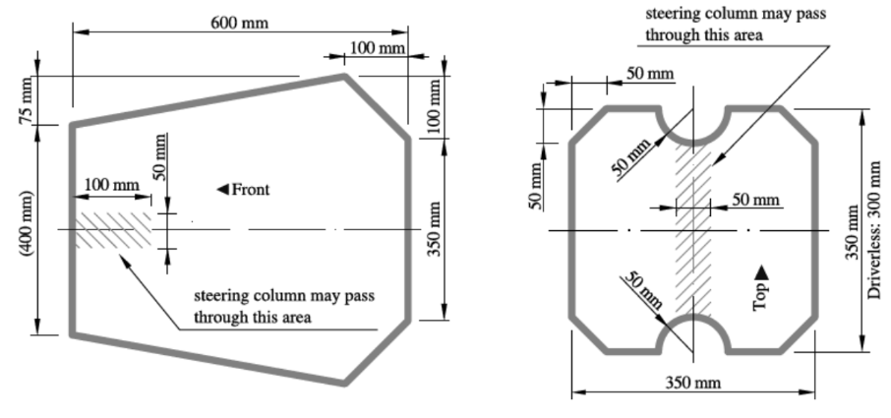
Problem definition
Clearance - The minimum requirements for helmet clearance from the frame is given in rule T3.10 describing the need to fit a 95th percentile male template .
Side impact structure - The side structure of the car must comply with rule T3.24 which places restrictions on tubing size used along with tubing placement.
Cockpit - The dimensions of the cockpit must comply with rule T4.1 and is required to pass the test at the competition. The cockpit must also meet rule T4.2 which gives a predefined cross section that must remain clear inside the vehicle. The driver must also be able to safely and quickly exit the cockpit by rule T4.8.

Slide 8
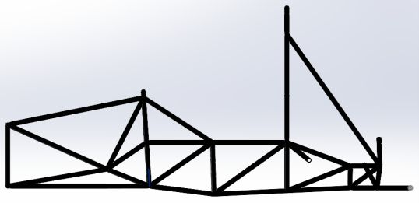
Comparison
Previous Year’s Chassis
Weight - 32439 gram
Torsional Stiffness - 968.72 Nm/deg
Present Year’s Chassis
Weight - 29076.91 gram
Torsional Stiffness - 838.125 Nm/deg

Slide 9
Features of the Chassis
Features | Values of present chassis frame | Values of previous chassis frame | Percentage Decrease
Kerb Weight | 29.07 Kg | 32.43 kg | 10.36%
Torsional Stiffness | 838.125 Nm/deg | 968.72 Nm/deg | 13.48%
Weight Distribution | 50:50 (Left - Right) | 50:50(Left - Right) | NA

Slide 10
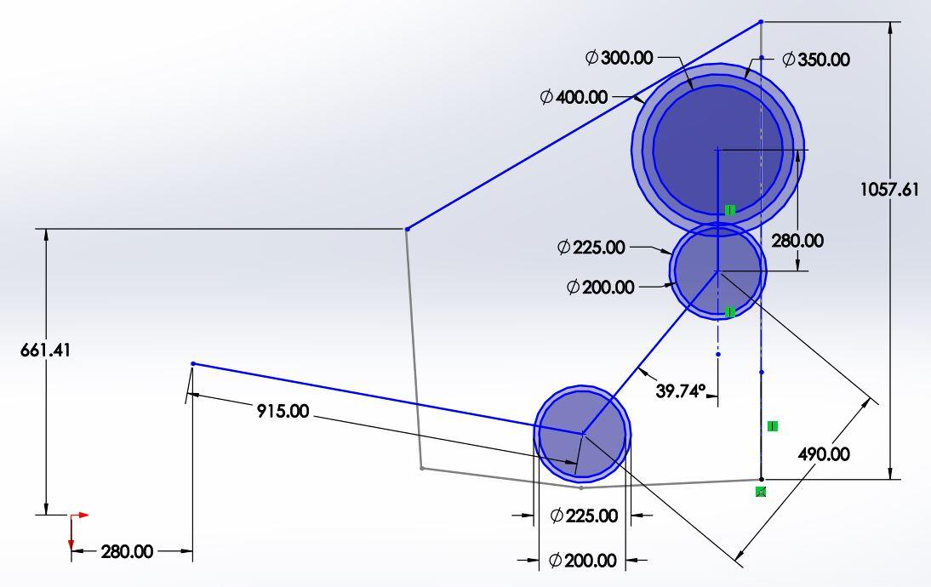
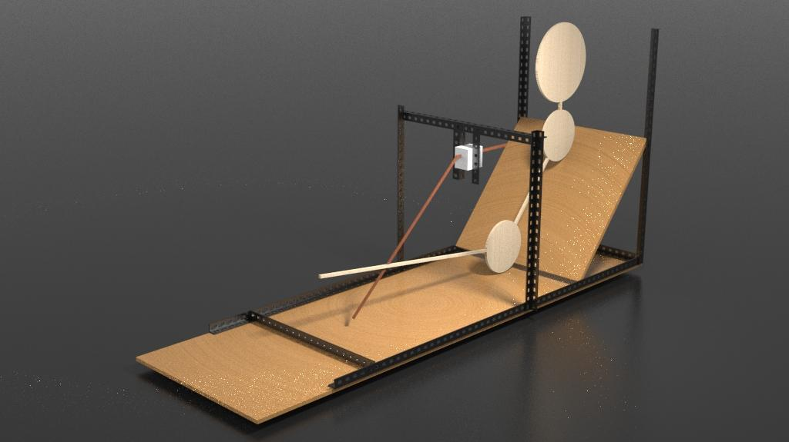
Ergonomics
Link

Slide 11
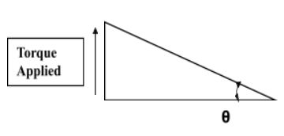
Calculations
Calculation of Torsional Stiffness
The horizontal distance between the center of the chassis and point of application of force is 2mm.The force applied this time for the analysis is 1000N. The maximum deformation in z-axis obtained from the ANSYS is 11.47 mm.
Calculations:
So the angle of displacement for the first case are as follow:-
θ = tan-1(11.47/532) = 1.2351°
So now the net torque applied is:-
T = Force*Distance
Torque = 1000*0.532*2
= 1064 Nm
So the torsional stiffness can be found by:-
=T /(Angular displacement= θ)
= 1064/1.2351
= 861.468 Nm/deg

Slide 12
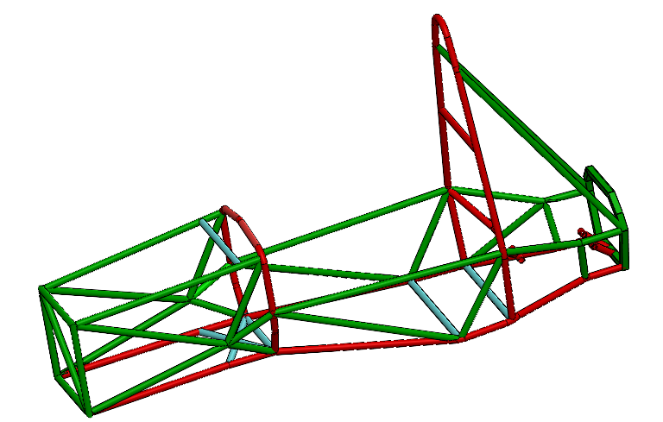

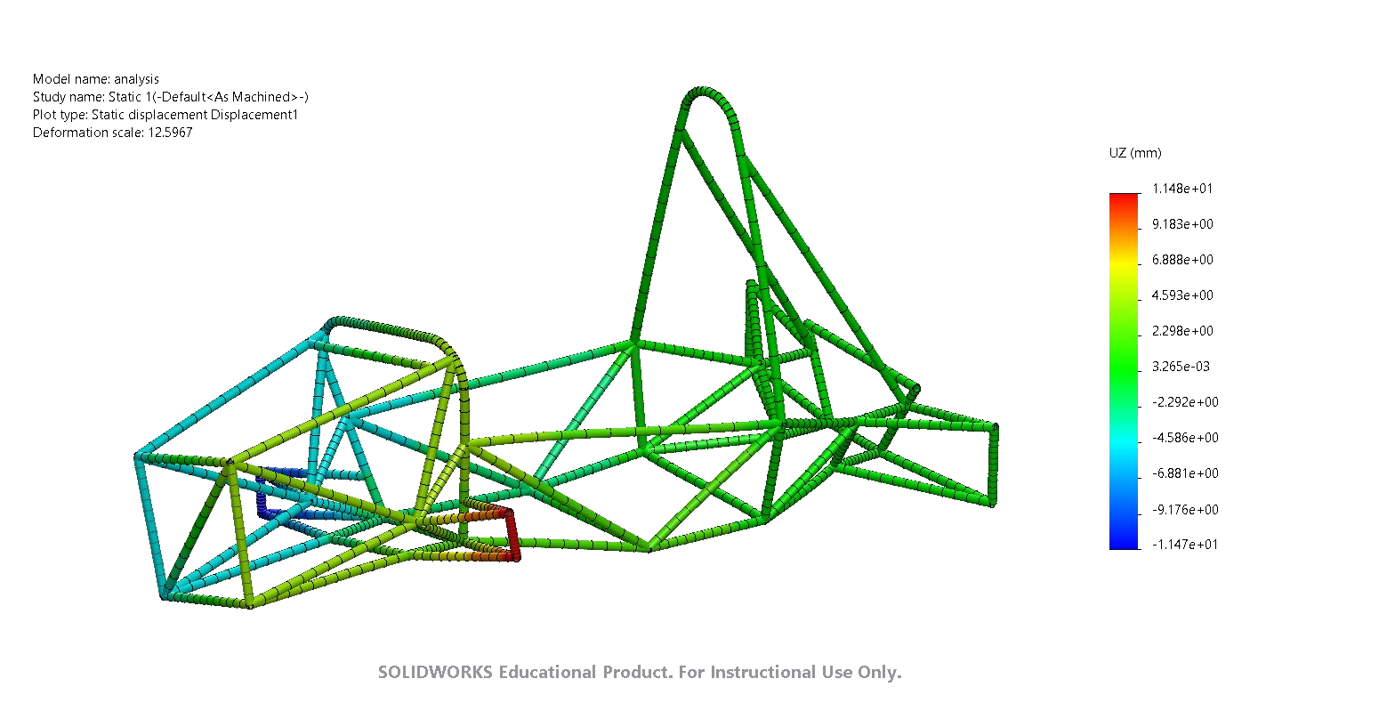
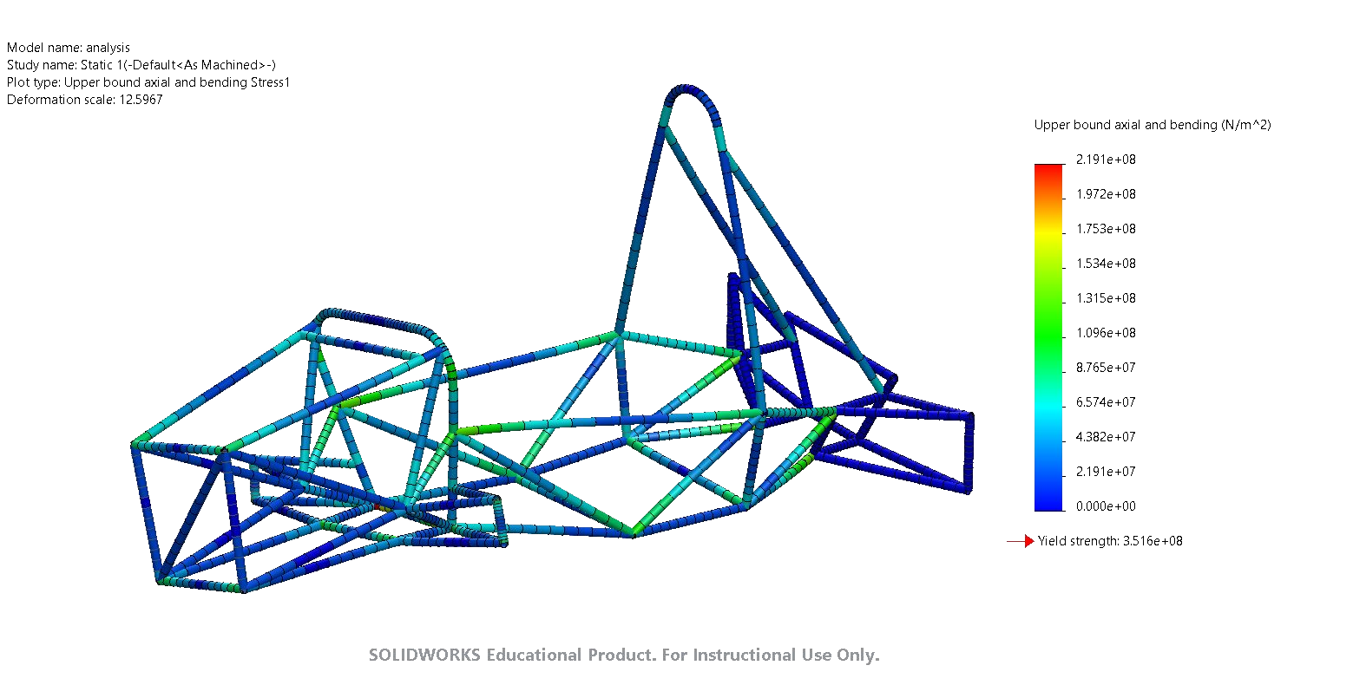
Analysis of Torsional Stiffness
Fixed nodes
Direction of force
Total Deformation
Equivalent Stress
Torsional Stiffness: 861.468 Nm/deg

Slide 13
Analysis of Frontal Impact
Mass of the Vehicle= 250 Kg
Velocity of the Vehicle= 20m/s or 72Km/h
Impact Force = Mass * (dv/dt)
= 250 * (20 - 0)
= 5000 N
To be on the safer side we have taken an additional factor of safety as 4 and the force which will then be considered was found out to be 20000N

Slide 14
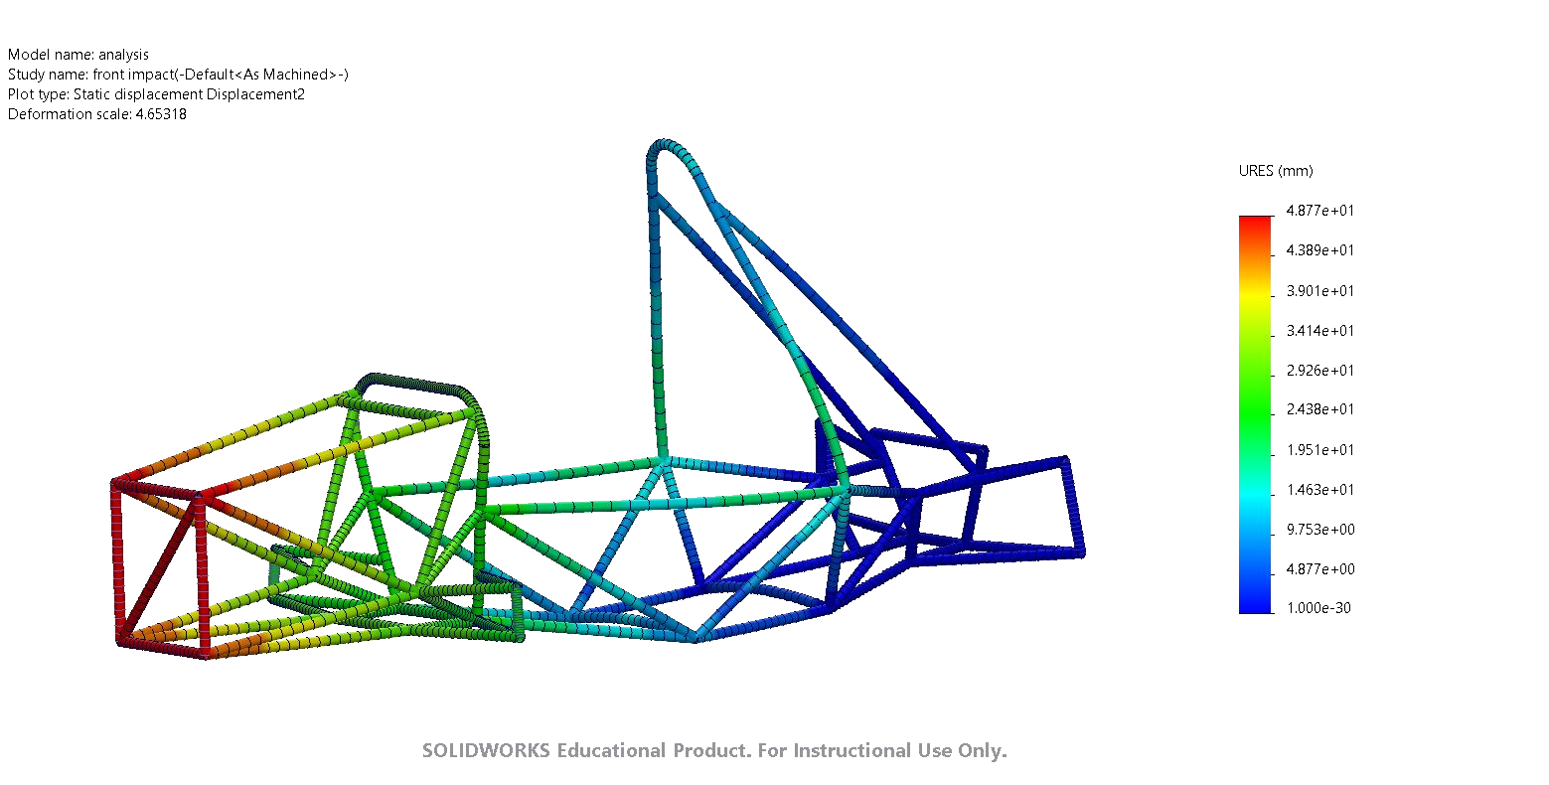
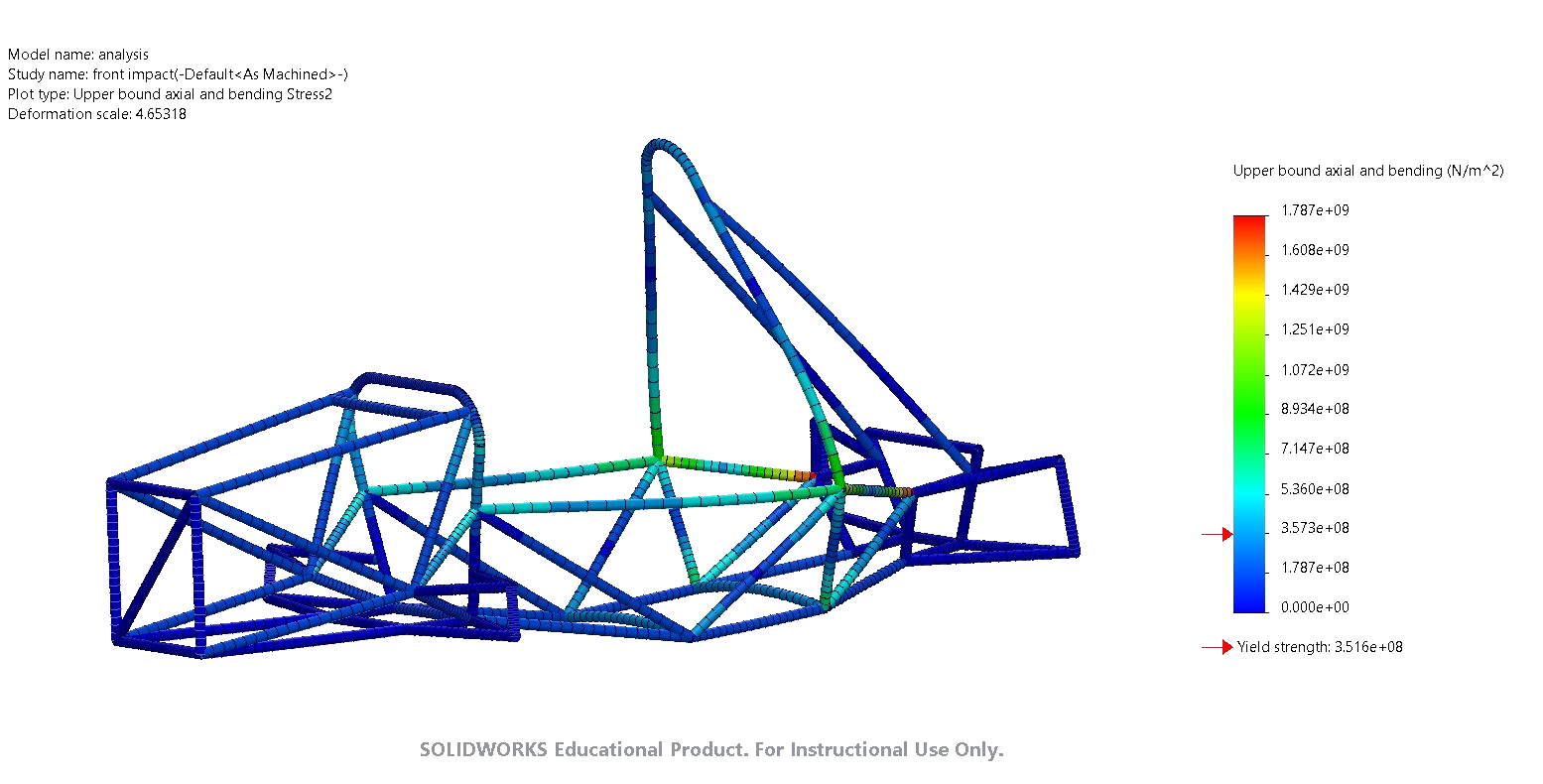
Analysis of Frontal Impact
Fixed nodes
Direction of force
Total Deformation
Equivalent Stress

Slide 15
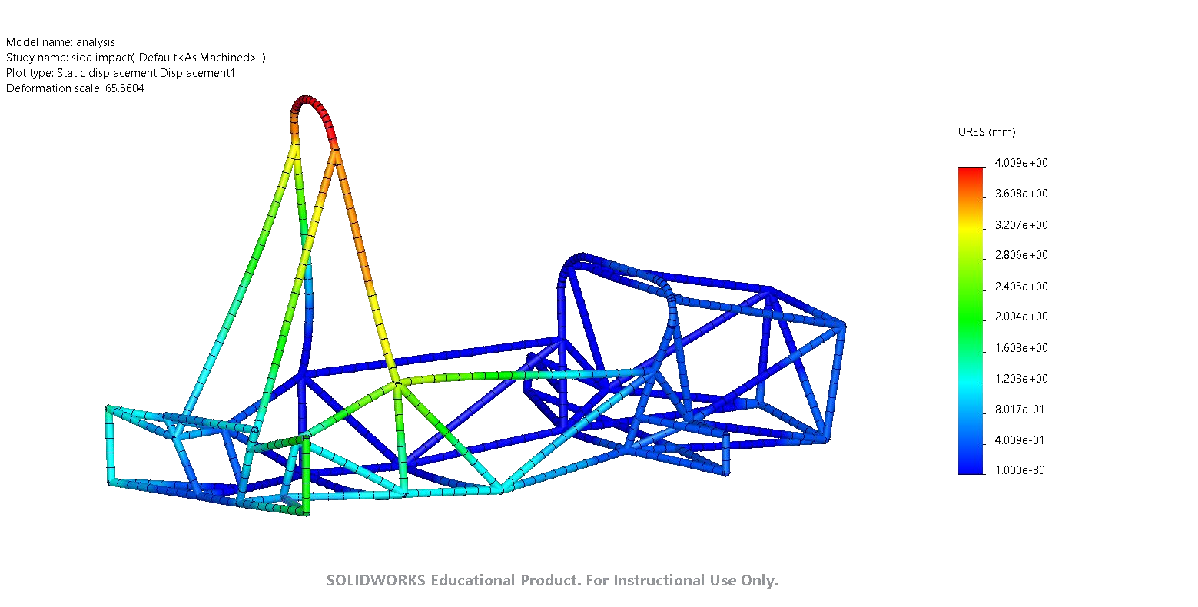
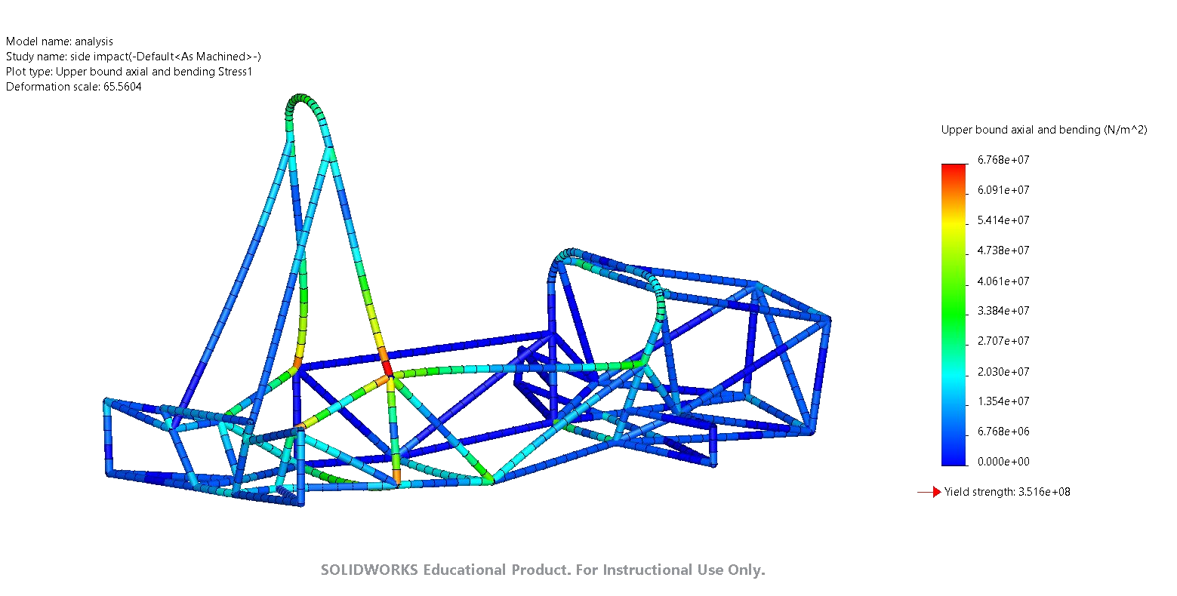
Analysis of Side Impact
Fixed nodes
Direction of force
Total Deformation
Equivalent Stress

Slide 16
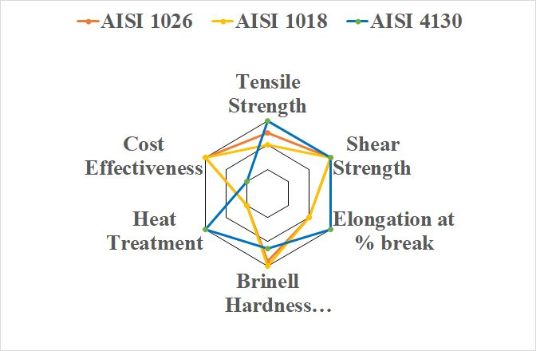
Material Selection
Properties | AISI 1018 | AISI 1026 | AISI 4130
Ultimate Tensile Strength | 440 MPa | 490 MPa | 530 MPa
Yield Strength | 370 MPa | 415 MPa | 435 MPa
Poisson Ratio | 0.3 | 0.3 | 0.3
Mass Density | 7800 kg/m^3 | 7800 kg/m^3 | 7800 kg/m^3
Young’s Modulus | 205 GPa | 200 GPa | 200 GPa

Slide 17
Conclusion
Our design has been improved upon and changed from our prior iteration.
We simulated each of them as well and obtain the desired results.
The FOS of all components reached an acceptable level (i.e more than 1.5 times).
The COG reading falls within the range of 250 to 320 mm, which is suitable for our 60-degree tilt test.

Slide 18
References
Referred Book: Race car vehicle Dynamics by William F. Milliken and Douglas L.
Milliken:https://iopscience.iop.org/article/10.1088/1742-6596/908/1/012042/meta
.Ergonomics:https://www.ijert.org/research/determination-of-ergonomics-for-formula-student-vehicle-IJERTV6IS030536.pdf
HR 17 Chassis Design CAD Model
Nimbus 390 Chassis Design CAD Model
Material AISI 1018:https://rb.gy/1h5vo
Material AISI 1026: https://www.azom.com/article.aspx?ArticleID=6583
Material AISI 4103: https://www.azom.com/article.aspx?ArticleID=6742

Slide 19
Thank you

